Slide 1
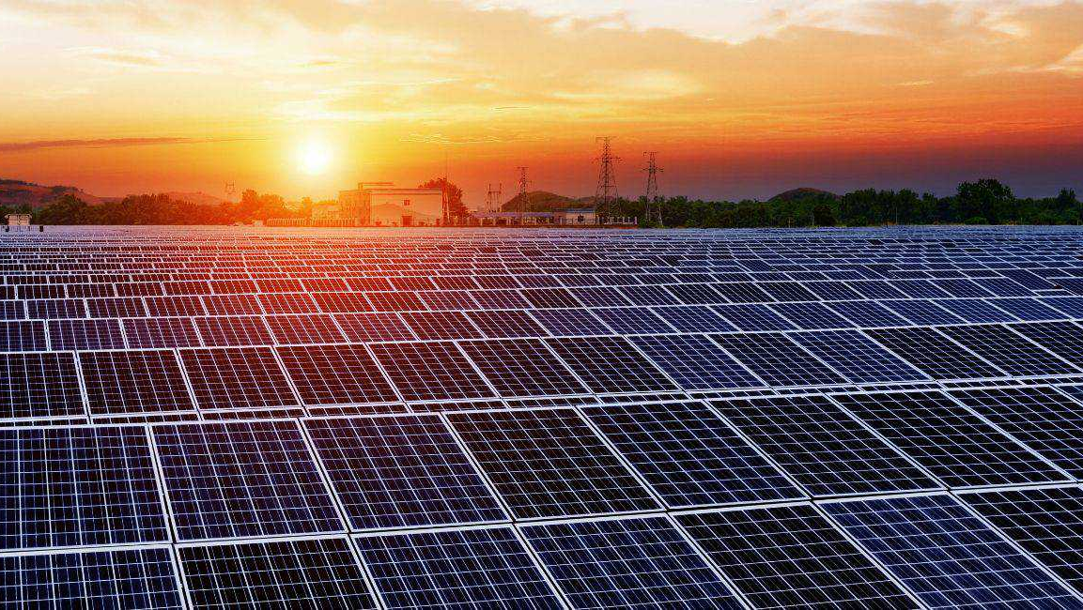


House of technology
Solar Energy – Electrical Contracting – Led Lighting – Engineering services
ENALUZ LIGHTING SYSTEMS

Slide 2
Content
1) About Us
2) Mission & Vision
3) Our Values
4,5,6) Go Solar
7,8,9) LED Lamps
10) LED Accessories
11,12) Portfolio
13) Contact Us

Slide 3
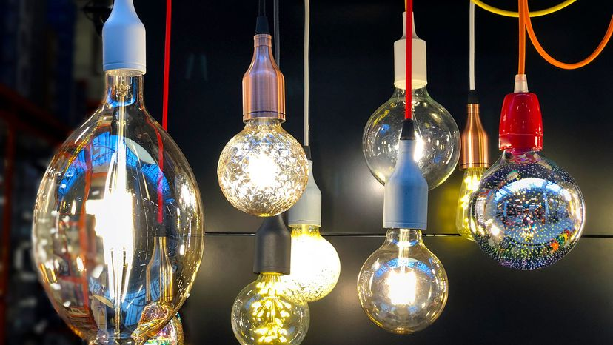
House Of Technology was Founded in 2003 as a Family-owned company in Solar Energy and Lighting Services based in Lebanon with a branch in Spain for Europe operations related to (Enaluz Lighting Systems). During years we undertook many electrical contractions for big centers, Where we installed CCTV and all kind of low current system, medium and low voltage project.
In 2010, we started medium size projects for Solar Energy On and off grid, Inside and outside Lebanon.
Nowadays, we became a regional reference in solar energy market, Lighting and all what consists of electrical work . We are the main supplier and distributers of SRNE inverters , OSDA (longi) panels and COOPOWER batteries. in France, Spain and Lebanon.
We advice and design lighting system for individuals or businesses such as restaurants, clubs, seaside resorts.
With our professional team that shares a common goal to offer the best experience to our clients , we provide a full-service portfolio for solar project that includes but not limited to , system advisory , system design , engineering installation and after sales services

Slide 4
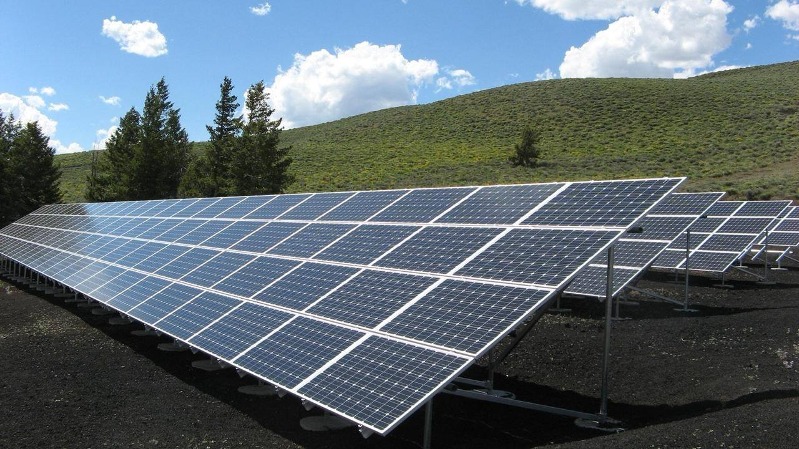


We are dedicated to deliver The highest quality of solar energy system and lighting products, with efficient solution always on time, along with expertise teamwork focusing on customer satisfaction.
To Facilitate People Lives through Efficient, Affordable and innovative energy solutions.

Slide 5
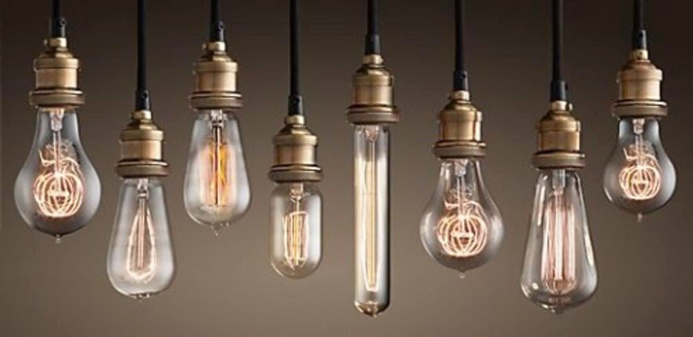

Striving to improve on excellence.
Offering the customers professional service by fulfilling their individual needs and expectations.
Advising the utilization of reliable and durable quality Solar products
Seeking to improve and updates our products since we are not dealers of unique product
Act ethically and honorably, we are committed in all that we do.

Slide 6
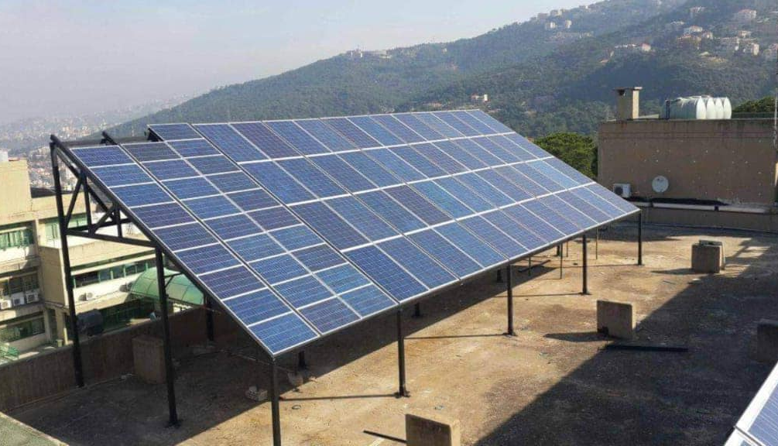
READY TO GO SOLAR ?
We Offer Consultation and design services for private users, Companies and Government facilities.
Solar PV system sizing options (e.g. how many solar watts are needed now and desired in the future )
Estimated solar power production scenarios (e.g how many kWh or kilowatt hours will be produced at photovoltaic panels) .
We also have experience in hybrid systems Solar/Diesel Generator, Solar/Grid, etc.
Off-grid systems supply remote locations not connected to the utility grid , Off-grid kits include off-grid solar panels, off-grid solar inverters, charge controllers, solar batteries, enclosures and mounting. Browse our selection of pole mounted kits, DC ready kits, generators, solar appliance kits and solar-ready battery systems. There are also HYBRID ON-GRID/OFF-GRID SYSTEMS that offer grid-related savings and backup power in the event of a grid failure.
Sagesse High School at Ain Saadeh - 100KV

Slide 7
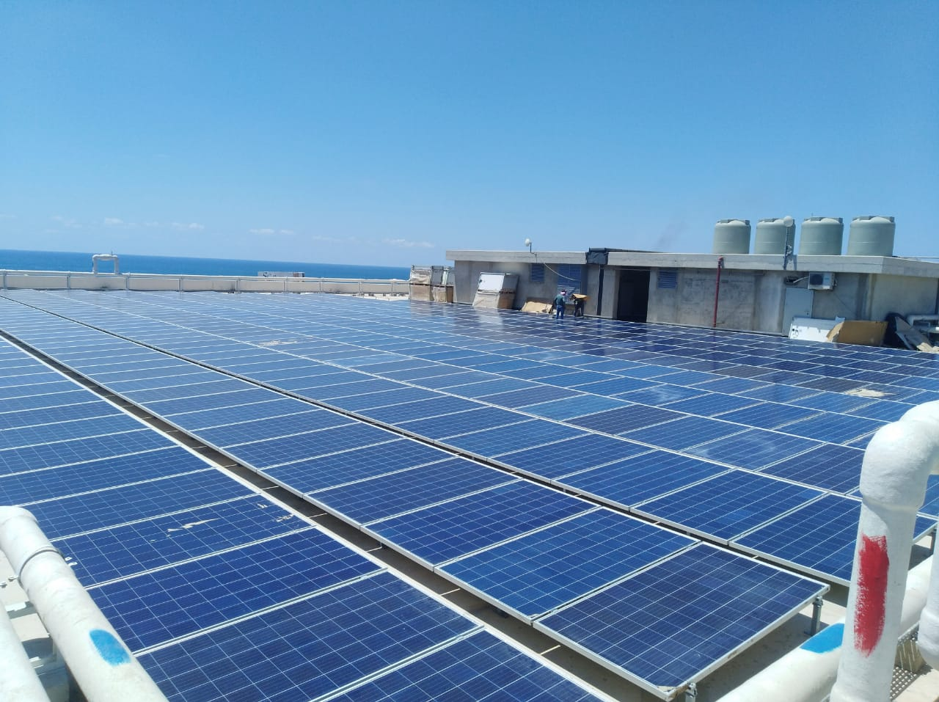
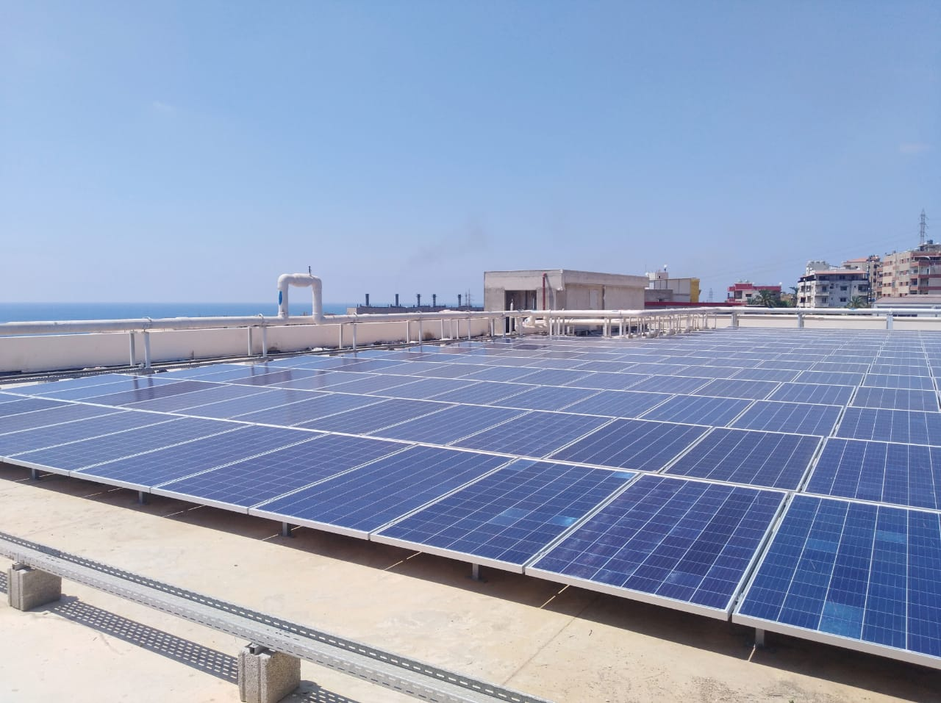
Our specialist solar design engineer will help you with the project, from design to installation, we provide you the best quality of solar panels inverters, batteries and all necessary equipment’s for a Successful installation and performance.
Mashmoushe Pharmaceutical Warehouses
Supply and installation of 500 kva solar generator

Slide 8
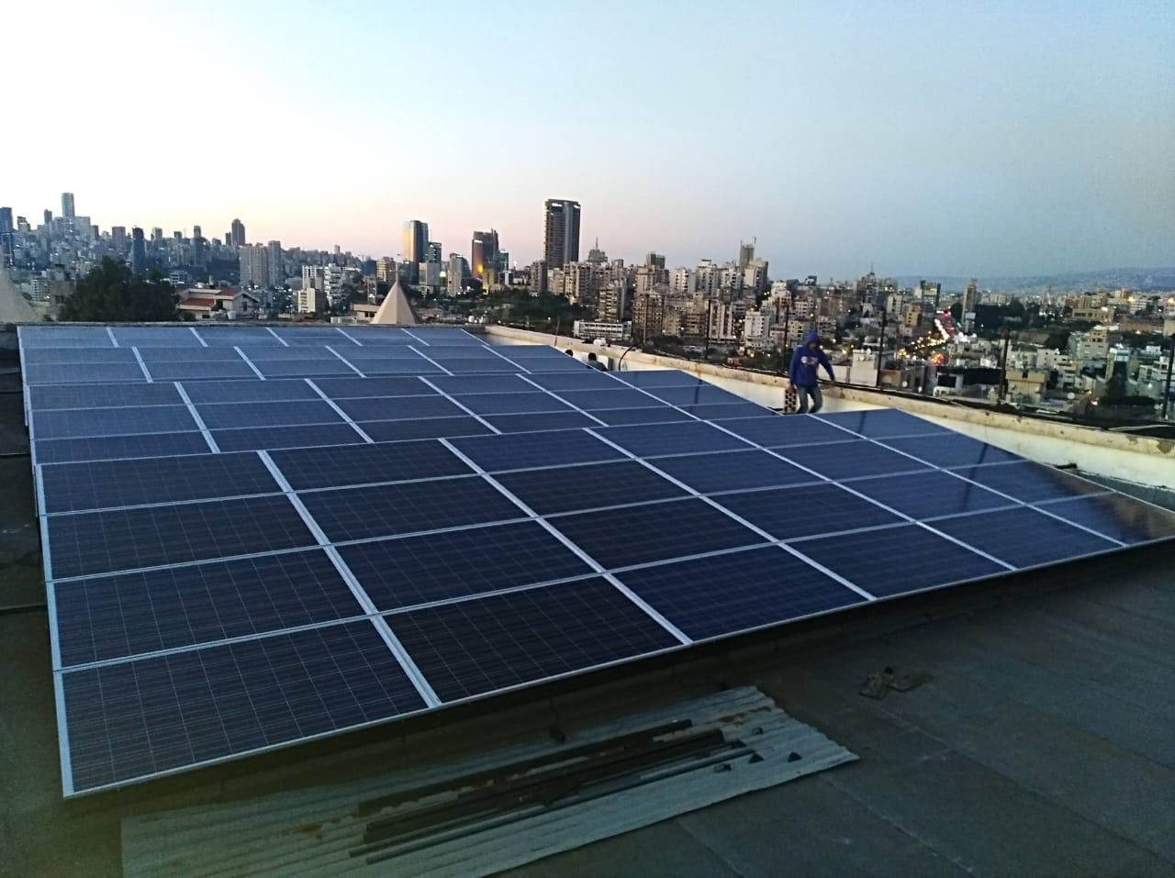
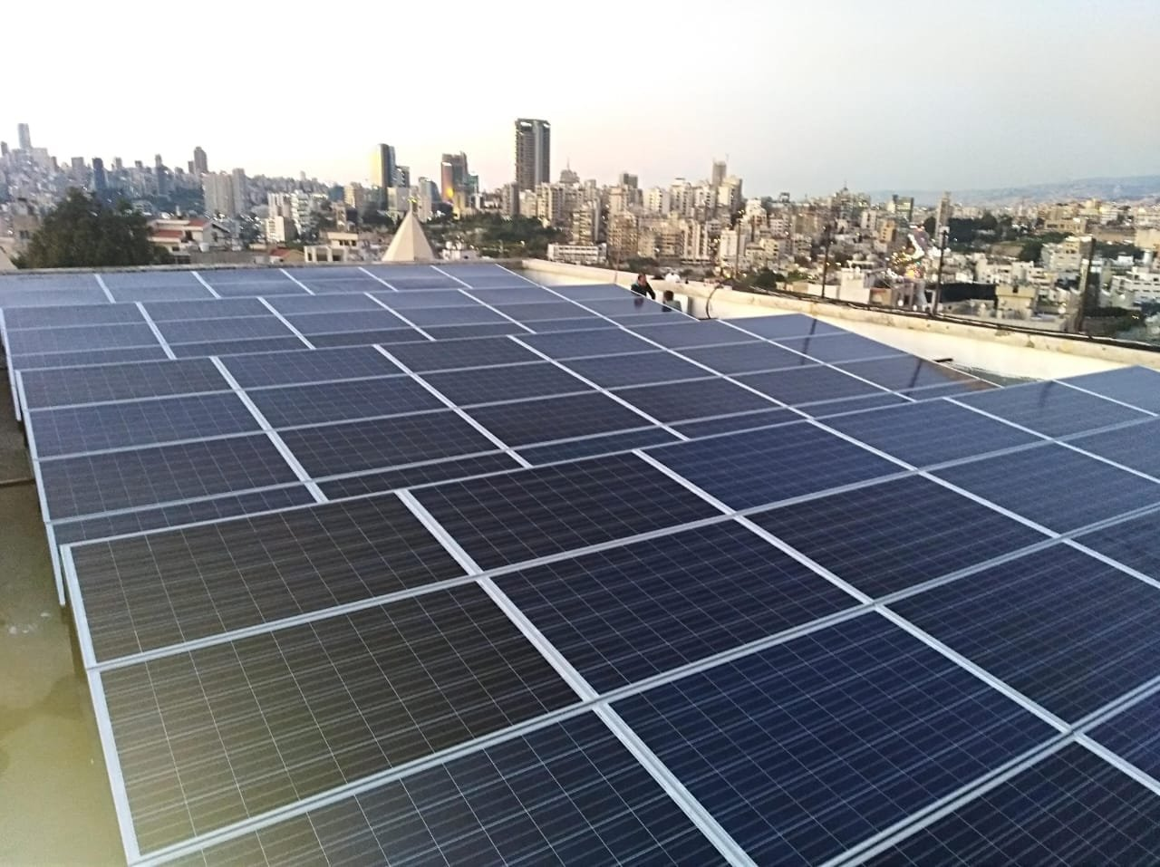
Our professional team will visit your premises and check the space availability, sun exposure and shades potential to do the necessary studies in order to install the best solar system solution that meets your needs and budget.
Mekhitarist School - Hazmieh Project
Solar on grid system of 24KW, connected to the private generator in order to reduce Diesel consumption. It helped the owner to reduce 180KWH to 200KWH or almost 1.882.260 LBP Daily as per Ministry of Energy and Water price for private generators (10.457LBP/KW)

Slide 9
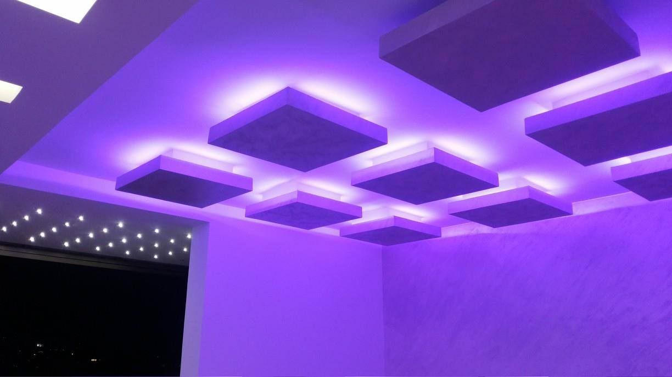
Add to the solar energy service, today House Of technology has grown to be one of the leading retailers with wide range of Led lights and accessories with affordable price and best quality in market .
Led Lighting technology enables the customer to obtain the same glow and brightness provided by normal lamps with complete freedom of choosing a mixture of diverse colors and designs along with much more power efficiency reaching 120 lumen/w and cost effectiveness .
Supply and installation of a huge variety of led spot that are great for focusing beams where they are needed the most, as they can be installed exactly where you need them. Each spot lamp can also be adjusted to throw a puddle of illumination across a particular area. We offer a wide range Of Led Light and LED accessories

Slide 10
Some of our Electrical and lighting projects
Central Bank Of Nigeria (HV/MV/LV) Installation
Phoenicia Intercontinental with ABB (MV network).
BLC Bank Zahle: Electrical contracting.
A-Z Manufactory: Electrical and Lightning
Pier 7 Night Club : Electrical and Lightning
Café La Joie : Electrical and Lightning
Maison du Caviar: Electrical and Lightning
Notre Dame Louaize school: Lightning
UTRIX : Electrical
EDDE SANDS : Electrical and Lightning
FAWAZ HOLDING : Electrical, Wind Turbine, PV Cell and Lightning
ABDEL RAHMAN AL WAZZAN : Electrical, Security (Cameras online), Lightning
Bistro De Moine Jemayze: Electrical contracting
Mazloum Tower: Electrical contracting
Magic Planet: Lightning
Villa Noor Bkassin: Electrical contracting
Glow Pub Beirut: Electrical contracting
Remiel Chocolate factory: Electrical contracting.
Subcontracting Beirut City Center BCC, From Al Bounian (Low and Medium Voltage)
BUILDERS : Lightning
HALIM EL ROUMI: Electrical and Lightning
PAUL KHAWEJA: Electrical and Lightning.
HARKOUS CHICKEN : Electrical and Lightning.
NABIL YEHYA CHEMLAN: Electrical and Lightning.

Slide 11
BANK DU LIBAN: Earthing system, Lightning Protection, Speech Threw System.
OTTICO & STUDIO OPTIC – BEIRUT SOUKS: Electrical and Lightning.
St ANTOINE CHURCH HARISSA: Electrical and Lightning
EDGARD ARAMOUNI BUILDING: Electrical, Lightning, St Security, Home Automation, Earthing, Lightning …
St JOSEPH CHURCH ACHRAFIEH: Electrical, Lighting, Security, Automation and Sound.
Restaurant-Pub-Nightclub: “CUBA LIBRE”, “SIDI”, and “MONOT THEATRE” : Electrical and Lightning
TRIPOLY PORT: Solar Street Lightning
BYBLOS SUD : Optical Fibre Lightning
BREIDY BUILDING: Lightning.
SKY BAR : Lightning
AGILITY : Lightning.
OGERO : Lightning
KHATER ENGINEERING: Controls
SINAAT : Lightning
CCI sarl: Lightning
MADISON HOTEL: Lightning
TOTAL GAS Station BAABDA : Lightning
HYPCO GAS STATIONS: Lightning
MOVENPIC: Lightning and Electrcial
AQUAMARINA : Lightning
SAYCO GLASS: Lightning.
EIGHT NIGHT CLUB - JORDAN : Lightning.
JORDANIAN RADIO & TV: Lightning, Electronic controls
BUILDERS : Lightning
HALIM EL ROUMI: Electrical and Lightning
PAUL KHAWEJA: Electrical and Lightning.
NABIL YEHYA CHEMLAN: Electrical and Lightning.

Slide 12

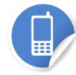

Our Team is ready to assist you
Head Office
Furn El Chebbak General Street Wakim Building, 1st Floor
Branch
Qabr Chmoun, main Road
Spain
Ronda Nord 4
46540 El Puig - Valencia
01/ 28 01 01
70/ 28 01 01
76/ 96 67 96
+34 636 525 232
Email : houseoftechnology.sarl@gmail.com
info@balansi.eu
Website:
Facebook : House Of Technology SARL

